Slide 1

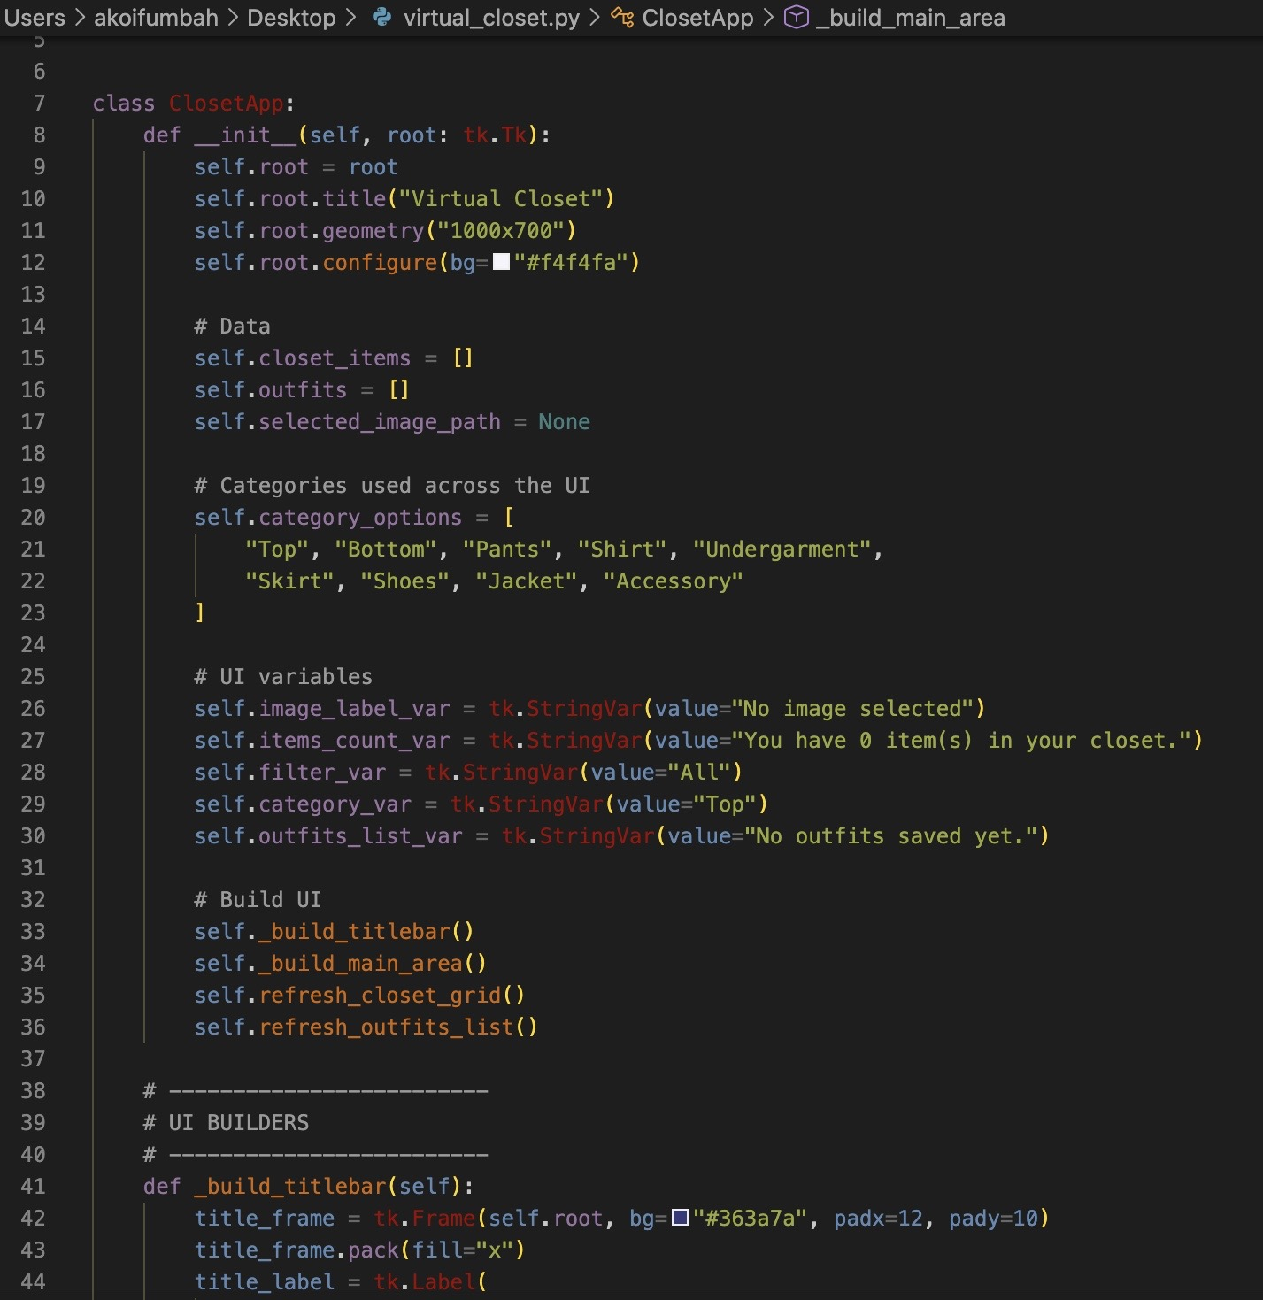
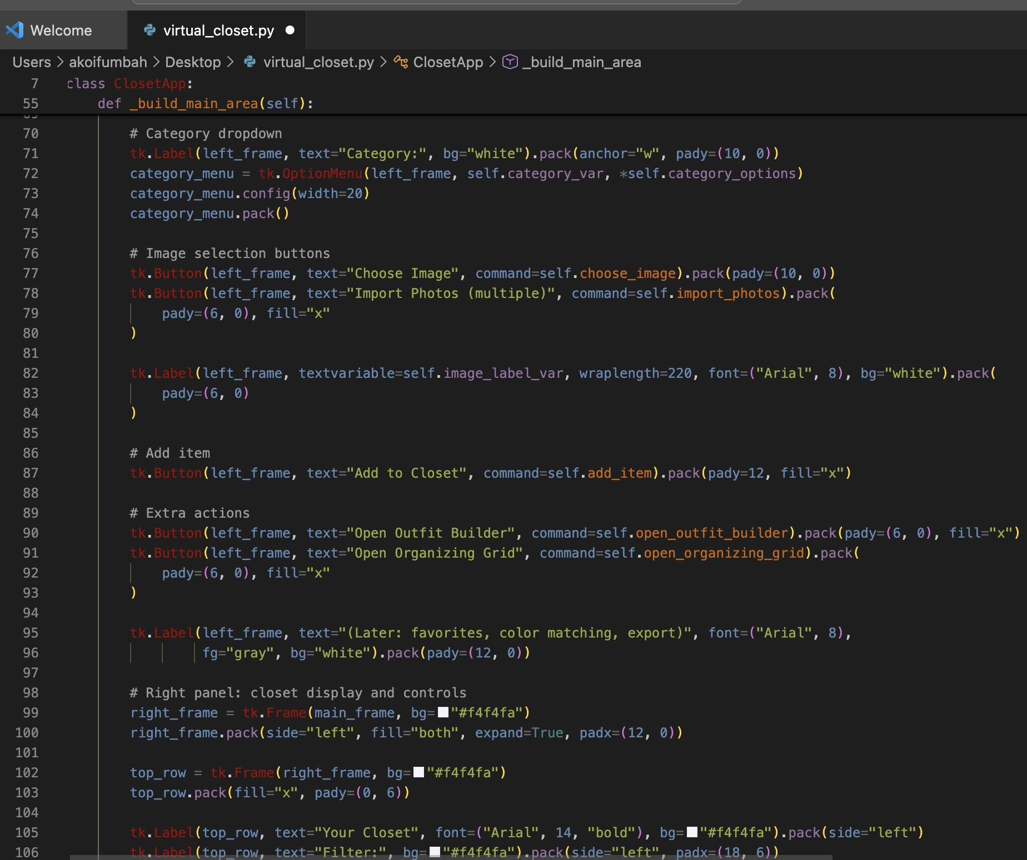
DRESS TO IMPRESS
Our Dress to Impress app lets you upload photos of the clothes in your closet and automatically organizes them into categories like tops, bottoms, shoes, and accessories. It then suggests stylish outfit combinations so you can pick great looks faster and with less effort.
Akoi Fumbah &
Kourtlyn Frazier

